Slide 1
Linear Regression

Slide 2
Data
Person | Height (inches) | Weight (pounds)
1 | 65 | 150
2 | 68 | 160
3 | 63 | 145
4 | 70 | 170
5 | 72 | 175
Mean height = (65 + 68 + 63 + 70 + 72) / 5 = 67.6 inches
Mean weight = (150 + 160 + 145 + 170 + 175) / 5 = 160 pounds

Slide 3
Variance and SD
Variance measures the dispersion or spread of a set of data points. It's calculated as the average of the squared differences from the mean. Here's how to calculate the variance for both height and weight
The standard deviation is the square root of the variance and provides a measure of the dispersion of data points from the mean. It's often used because it's in the same unit as the original data, making it easier to interpret.
Height | Deviation from mean | Weight | Deviation from mean
65 | 65 - 67.6 = -2.6 | 150 | 150 – 160 = -10
68 | 68 - 67.6 = 0.4 | 160 | 160 – 160 = 0
63 | 63 - 67.6 = -4.6 | 145 | 145 – 160 = -15
70 | 70 - 67.6 = 2.4 | 170 | 170 – 160 = 10
72 | 72 - 67.6 = 4.4 | 175 | 175 – 160 = 15
Variance (H) = [(65 - 67.6)² + (68 - 67.6)² + (63 - 67.6)² + (70 - 67.6)² + (72 - 67.6)²] / 5 ≈ 11.88 square inches²
SD = √(11.88) ≈ 3.45 inches
Variance (W) = [(150 - 160)² + (160 - 160)² + (145 - 160)² + (170 - 160)² + (175 - 160)²] / 5 ≈ 130 pounds²
SD = √(130) ≈ 11.40 pounds

Slide 4
Covariance
Covariance measures the degree to which two variables change together.
If the covariance is positive, it indicates that the variables tend to increase or decrease together.
If it's negative, it indicates that one variable tends to increase as the other decreases.
Covariance between height and weight:
Covariance = Σ [(Height - Mean Height) * (Weight - Mean Weight)] / (n - 1) =
[(65 - 67.6)(150 - 160) + (68 - 67.6)(160 - 160) + ... + (72 - 67.6)*(175 - 160)] / 4 ≈
[(-2.6 * -10) + (0.4 * 0) + (-4.6 * -15) + (2.4 * 10) + (4.4 * 15)] / 4 ≈
(26 + 0 - 69 + 24 + 66) / 4 ≈ 11.75
The positive covariance means that taller individuals tend to have heavier.

Slide 5
Standard Units
A way of measuring variables in any numerical unit
Measures how many SDs above or below average a value is
z = (value - average) / SD
negative z: value below average
positive z: value above average
z = 0: value equals average
When values are in standard units, average = 0, SD = 1
You can expect most of the data (about 96%) to be in the range -5 to 5 when converted to standard units

Slide 6
Standard Units
Height (inches) | Height (z-score) | Weight | Weight (z-score)
65 | (65−67.6) / 3.45 = −0.7536 | 150 | (150 – 160) / 11.40 = −0.8771
68 | (68−67.6) / 3.45 = 0.4637 | 160 | (160 – 160) / 11.40 = 0
63 | (63−67.6) / 3.45 = −1.333 | 145 | (145 – 160) / 11.40 = −1.3157
70 | (70−67.6) / 3.45 = 0.6956 | 170 | (170 – 160) / 11.40 = 0.8771
72 | (72−67.6) / 3.45 = 1.2753 | 175 | (175 – 160) / 11.40 = 1.3157

Slide 7
Regression
Using the method of least squares to fit a linear model to the data.
Data preparation:
Organize the dataset into two arrays: one for the independent variable (height) and one for the dependent variable (weight)
Convert values to standard units
Calculate the correlation coefficient
r = np.mean (x_su * y_su)
For our data, r = ((−0.7536 * −0.8771) + 0 + (−1.333 * )(−1.3157) + (0.6956) * (0.8771) + (1.2753 * 1.3157)) / 5
Slope of the regression line in original units: r * (SD of y) / (SD of x)
Intercept of the regression line: average of y – slope * average of x

Slide 8
Question 1: Correlation
Let’s start by writing a function called correlation_coefficient that takes in two arrays x and y of the same length and returns the correlation coefficient between the two.
Hint: Assume you have a function called convert_su defined, that converts an array to standard units (we did this last week).
def correlation_coefficient(x, y):
x_su = convert_su(x)
y_su = convert_su(y)
return np.mean(x_su * y_su)

Slide 9
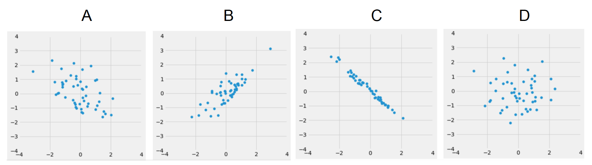
Question 2: Comparing Correlation
Rank them from weakest correlation to strongest correlation.

Slide 10
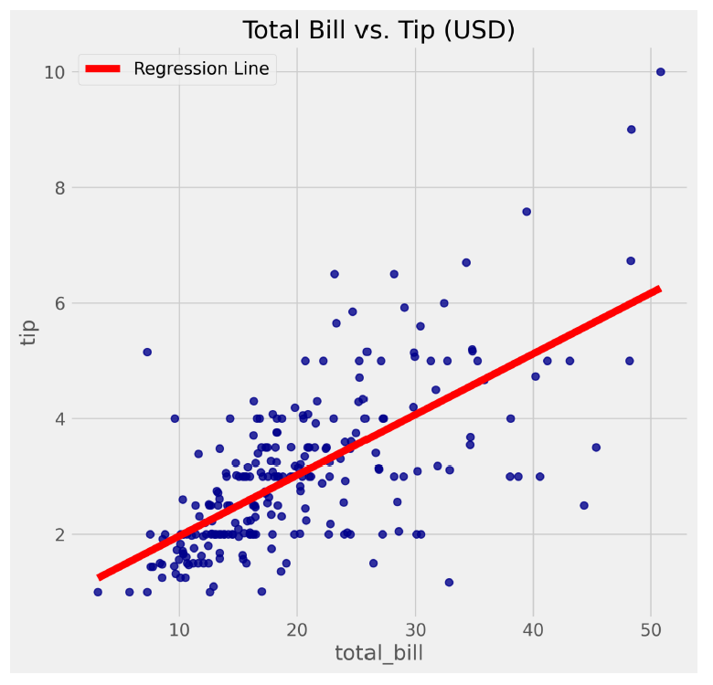
Question 3:
Suppose your friend Alice goes out to dinner and tells you her total bill was $35. Based on the regression line, what would we predict Alice’s tip to be?

Slide 11
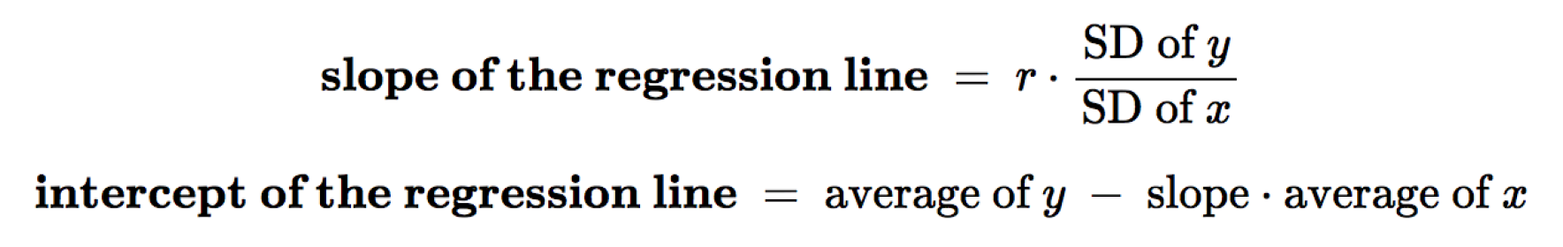
Slope and Intercept of the Regression Line in original units
This comes from the general equation of a line:
y = mx + b
b = y - mx

Slide 12
Question 4:
We want to investigate the correlation between the daily ounces of coffee consumed by an individual and the number of hours the individual stayed awake. It is our intention to use the ounces of coffee consumed (x) to predict the number of hours (y) the individual stayed awake. The data from our sample of 500 people has the following characteristics:
The number of ounces of coffee consumed has a mean of 12 ounces and SD of 4
The number of hours stayed awake has a mean of 16 and an SD of 2
The correlation between the number of ounces of coffee consumed and number of hours spent awake is 0.5.
Suppose the scatter plot is roughly linear

Slide 13
Question 4
What is the slope of the regression line?
Slope = r * (SD of y / SD of x)
Slope = r*(2/4) = 0.5*0.5 = 0.25
What is the intercept of the regression line?
Intercept = 16 - 0.25*(12) = 13
Suppose your friend Matthew is in this population (and not in the sample). He told you that he consumed 16 ounces of coffee that morning. Use your line of best fit to predict how many hours Matthew will stay awake today.
y = mx + b
0.25(16) + 13 = 17
Your other friend, Meghan, is also in the population and not in the sample. She confesses that she drank 80 ounces of coffee that day (wow!). Based on the information above, would the regression line we computed in parts (a) and (b) be appropriate to predict the number of hours Meghan stayed awake? Explain.
0.25(80) + 13 = 33 hours
Meghan’s datapoint is 17 SDs above the mean, making it an outlier. This method is not appropriate.

Slide 14
Linear Regression Review
y = m * x + b is the general equation for a line, where ( m ) is the slope and ( b ) is the y-intercept
In standard units, a regression line is a line that passes through the origin (0,0) and it is typically used to estimate y values for any given x value.
In standard units, the slope of the regression line is also known as the correlation coefficient. This coefficient is always a number between -1 and 1.
1 means all points are on a straight line with a positive slope
-1 means that all points are on a straight line with a negative slope
0 means that there is no linear relationship
Regression lines that are in original units have not been centered at the origin (0,0) and they have not been scaled to match with standard units.
The slope of the regression line in original units = r * (SD of y) / (SD of x)
SD = standard deviation is a measure of data spread
This rearranged equation tells us that regression slopes will only be large (showing high correlation) for:
Large SD of y: The y values have enough spread, so you can make different y predictions for different values of x
Small SD of x: The x values are not too spread out, a small change in x has a significant effect on y

Slide 15
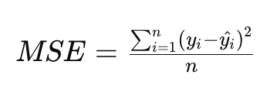

Root Mean Square Error
The mean squared error or MSE is a measure of the average squared difference between the observed values and the values predicted by a model. It's commonly used to evaluate the performance of regression models.
The root mean square error (RMSE) is another commonly used metric to evaluate the performance of regression models. It's similar to the mean squared error (MSE), but it's the square root of the average of the squared differences between the observed values and the predicted values.
The regression line is the line that minimizes the RMSE

